Slide 1


PCMH/HH Learning Collaborative Successes of 2015

Slide 2
Maine PCMH Pilot/HH NEW Timeline!
Jan 1, 2010
2011
2012
2013
2014
2015
2016
ME PCMH Pilot - Original
MAPCP Demo (5yr!)
Jan 1, 2012
MaineCare HHs
Jan 1, 2013
MaineCare BHHs
ME PCMH Pilot – Extended Timeline
Pilot Expansion (Jan 2013)
Dec 31, 2016

Slide 3
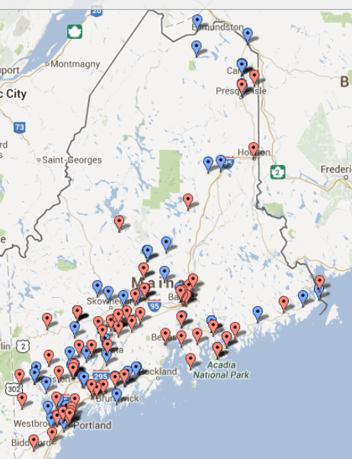
ME PCMH Pilot & Health Homes Practice Sites

Slide 4
Maine PCMH Pilot – MAPCP – Health Homes Practice Participation Timeline
2010 2011 2012 2013 2014 2015 2016 2017 Beyond..
25 PCMH Pilot Phase 1 (23 HHs)
Payers:
Medicare
Medicaid
Anthem
Aetna
HPHC
50 Phase 2/ HH Practices
71 HH practices (SIM)
(Cohort 1 – Jan 2013)
Payer:
Medicaid
?
9 HH practices
(Cohort 2 – July 2013)
22 HH practices
(Cohort 3– April 2014)
23 HH practices
(Cohort 4 January 2015)

Slide 5
PCMH/HH 2014
Support and technical assistance provided to all 175+ PCMH and Health Home practices
  On-site Quality Improvement Specialist support
Networking opportunities and education provided through Learning Collaborative
  Monthly webinars (average 115 participants per month)
  3 Learning Sessions
    Attendance steadily growing
    Over 600 attendees at last Learning Session (combined collaborative event with BHHs)
  2 sets of Regional Forums (230 – 300 participants per set)

Slide 6
Practice Performance Keeps Improving!
18 Must Pass Core Expectations fully implemented
All 3 screenings being performed

Slide 7

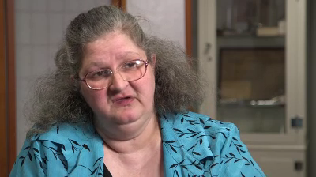
Innovation in Action
Tina is the daughter of a DFD Russell patient.

Slide 8
Bucksport Regional Health Center
Successes Since Becoming a Health Home:
  Lower Cost of Healthcare
  Fewer ER visits
  Fewer Re-hospitalizations
  Less institutionalization of patients
  Dedicated staff for Women’s Health, Preventative Health which includes colorectal cancer screening, cervical cancer screening and many others.
  Integration of Behavioral Health and Physical Health

Slide 9
Looking Ahead to 2015 and Beyond
Reviving the Heart of Primary Care
Moving beyond ‘just checking the box’
Building personal & professional resiliency
Establishing or reviving team synergy
Finding a good work-life balance
Rediscovering the joy in practice
Sustaining transformative changes

Slide 10




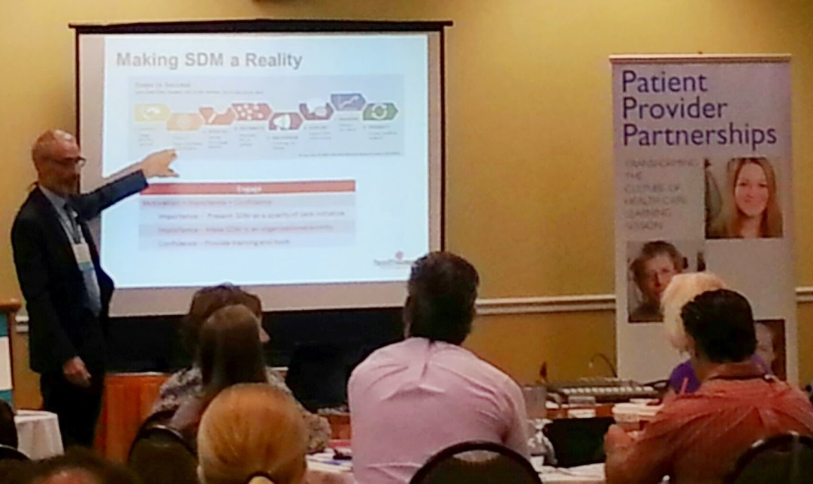
Patient-Provider Partnerships (P3)
Year 1 Successes

Slide 11
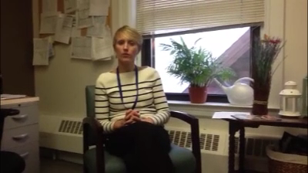
The Practice Perspective

Slide 12

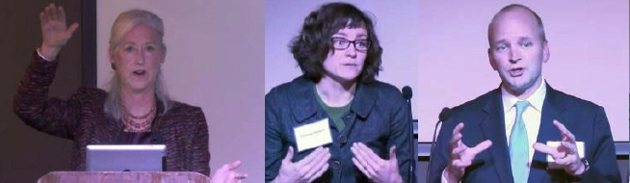

P3 Year 1 - Successes

Slide 13
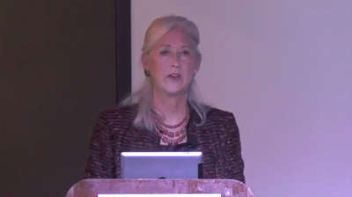
Shannon Brownlee – Health Care Town Hall

Slide 14
P3 – Looking Ahead…
P3 Pilot Initiative ends March 31, 2015
  Patient-Provider Partnership embedded in the practice culture of pilot sites
Health Care Town Hall Meeting
  3rd and final Town Hall Meeting on March 18, 2015
    The 21st Patient: Informed, Engaged, Empowered with Dave deBronkart, “e-patient Dave”
  Initiation of Lown Institute “Community Conversations” after November Town Hall

Slide 15
Behavioral Health Homes Learning Collaborative Successes of 2014
Support and technical assistance provided to all 24 Behavioral Health Home organizations (BHHO) at 60 sites
  Site Visits
  Baseline assessment
  Technical assistance and support
8 webinars held with 253 participants
3 Learning Sessions held with 228 participants

Slide 16

Tri-County Mental Health Services (TCMHS):
A Success Story
69 to 1
In the year prior to BHH Services, one client served by TCMHS was in the Emergency Department (ED) 69 times.
Since enrolling in BHH services, he has been in the ED once.

Slide 17

United Cerebral Palsy (UCP) of Maine:
A Success Story
13 to 5
UCP’s Nurse Care Manager used the MaineCare portal and noted that one child was on 13 medications.
Working with the family, a new provider, and a medical reconciliation process, the medications were reduced to 5.
The child is happier, healthier, has lost weight, is able to stay in school, and has avoided a Spring Harbor hospitalization.

Slide 18
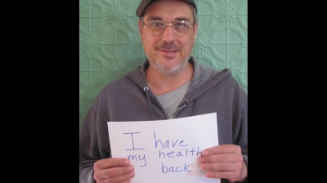
Signs of Success

Slide 19
Behavioral Health Homes Learning Collaborative
Plans for 2015
Welcome and provide support to 3 new Behavioral Health Home organizations
Holding the Gains! Support BHHOs in…
  Quality Improvement: reducing avoidable hospitalizations, unnecessary ED use and high utilizers
  Population Management and Risk Stratification: using the portal and developing systems
  Support in working toward Health Information Technology requirement in the BHH MaineCare rule

